Slide 1

Samen sterk: naar een reflectieve corporatie
Workshop Van goeden huize
Donderdag 19 mei 2022
Gert de Jong

Slide 2
Belang van reflectie
Een reflectieve cultuur heeft positieve invloed op de waardering van de ocf
én de effectiviteit van het werk
Het gaat dan om ‘corporatiebrede reflectie’
Niet alleen heidagen van het MT
Doel:
Versterken van reflectieve cultuur in corporaties

Slide 3
Opzet
Wat
  Enkele omschrijvingen van reflecteren
Waarop
  Managementcontrolsystemen
Hoe
  Methoden en benaderingen van reflectie
Wanneer
  Aanleiding voor reflectie

Slide 4
Wat is reflecteren
Wat

Slide 5

Wat is reflecteren

Slide 6


Slide 7
Wat is reflecteren?
“Reflecteren is te beschouwen als terugblikken op een ervaring (…) en kijken naar de context waarin deze plaatsvond. Je wordt je bewust van deze ervaring, en geeft er betekenis aan, om van daaruit keuzes te maken voor nieuwe perspectieven”
  (Geenen,2019, p.4)
“Het doel van reflecteren als vaardigheid is: bewustwording van en inzicht krijgen in beweegredenen voor en effecten van eigen handelen”
  (Groen, 2011, p. 138)
“Reflection represents the necessary link between
experience and goal-oriented learning”
  (Pekkola, 2015, p. 18)

Slide 8
Kenmerken
Zoekende houding
Doorbreken van psychologische en sociologische wetmatigheden
  Fundamentele attributiefout
  Cognitieve dissonantie
  Blinde vlek
Herstructureren van kennis en vaardigheden
Het bevragen van het gebruikelijke, het intuïtieve

Slide 9
Reflecteren en evalueren
Evalueren
Het gaat om de taak
Je kijkt naar product of proces
Reflecteren
Het gaat om het gedrag
Je kijkt naar persoon (jezelf)

Slide 12
Management-controlsystemen
Waarop

Slide 13
Management control
Management control (…) incluses all the devices or systems managers use to ensure that the behaviors and decisions of their employees are consistent with the organization’s objectives and strategies.
The systems themselves are commonly referred to as the mangement control systems (MCSs).
Merchant & Van der Stede, 2007, p5
Malmi & Brown (2008) onderscheiden vijf ‘packages’
  Die zagen we in de kennisclip
  en in het diagram

Slide 14

Five packages: Planning Control
Planning | Ex-ante form of control, first it sets out the goals of the functional areas of the organisation thereby directing effort and behaviour; second, it provides the standards to be achieved in relation to the goal, making clear the level of effort and behaviour expected; third, it enables congruence by aligning goals across the functional areas of an organisation, thereby controlling the activities of groups and individuals
Cybernatic | There are five characteristics of cybernetic control. First, there are measures that enable quantification of an underlying phenomenon, activity or system. Second, there are standards of performance or targets to be met. Third, there is a feedback process that enables comparison of the outcome of the activities with the standard. This variance analysis arising from the feedback is the fourth aspect of cybernetic control systems. Fifth is the ability to modify the system’s behaviour or underlying activities.
Reward/ compensation | Motivating and increasing the performance of individuals and groups through attaching rewards to control effort direction, effort duration, and effort intensity.
Administrative | Administrative control systems are those that direct employee behaviour through the organizing of individuals (organisation design and structure), the monitoring of behaviour and who employees are made accountable to for their behaviour (governance); and through the process of specifying how tasks or behaviours are to be performed or not performed (policies and procedures)
Culture | The values, beliefs and social norms which are established influence employees behaviour.

Slide 15

Five packages: Cybernatic Control
Planning | Ex-ante form of control, first it sets out the goals of the functional areas of the organisation thereby directing effort and behaviour; second, it provides the standards to be achieved in relation to the goal, making clear the level of effort and behaviour expected; third, it enables congruence by aligning goals across the functional areas of an organisation, thereby controlling the activities of groups and individuals
Cybernatic | There are five characteristics of cybernetic control. First, there are measures that enable quantification of an underlying phenomenon, activity or system. Second, there are standards of performance or targets to be met. Third, there is a feedback process that enables comparison of the outcome of the activities with the standard. This variance analysis arising from the feedback is the fourth aspect of cybernetic control systems. Fifth is the ability to modify the system’s behaviour or underlying activities.
Reward/ compensation | Motivating and increasing the performance of individuals and groups through attaching rewards to control effort direction, effort duration, and effort intensity.
Administrative | Administrative control systems are those that direct employee behaviour through the organizing of individuals (organisation design and structure), the monitoring of behaviour and who employees are made accountable to for their behaviour (governance); and through the process of specifying how tasks or behaviours are to be performed or not performed (policies and procedures)
Culture | The values, beliefs and social norms which are established influence employees behaviour.

Slide 16

Five packages:
Reward/ compensation Control
Planning | Ex-ante form of control, first it sets out the goals of the functional areas of the organisation thereby directing effort and behaviour; second, it provides the standards to be achieved in relation to the goal, making clear the level of effort and behaviour expected; third, it enables congruence by aligning goals across the functional areas of an organisation, thereby controlling the activities of groups and individuals
Cybernatic | There are five characteristics of cybernetic control. First, there are measures that enable quantification of an underlying phenomenon, activity or system. Second, there are standards of performance or targets to be met. Third, there is a feedback process that enables comparison of the outcome of the activities with the standard. This variance analysis arising from the feedback is the fourth aspect of cybernetic control systems. Fifth is the ability to modify the system’s behaviour or underlying activities.
Reward/ compensation | Motivating and increasing the performance of individuals and groups through attaching rewards to control effort direction, effort duration, and effort intensity.
Administrative | Administrative control systems are those that direct employee behaviour through the organizing of individuals (organisation design and structure), the monitoring of behaviour and who employees are made accountable to for their behaviour (governance); through the process of specifying how tasks or behaviours are to be performed or not performed (policies and procedures)
Culture | The values, beliefs and social norms which are established influence employees behaviour.
Frappant: wordt weinig genoemd.
We doen het werk ongeacht beloning
We hebben het er liever niet over

Slide 17

Five packages: Administrative Control
Planning | Ex-ante form of control, first it sets out the goals of the functional areas of the organisation thereby directing effort and behaviour; second, it provides the standards to be achieved in relation to the goal, making clear the level of effort and behaviour expected; third, it enables congruence by aligning goals across the functional areas of an organisation, thereby controlling the activities of groups and individuals
Cybernatic | There are five characteristics of cybernetic control. First, there are measures that enable quantification of an underlying phenomenon, activity or system. Second, there are standards of performance or targets to be met. Third, there is a feedback process that enables comparison of the outcome of the activities with the standard. This variance analysis arising from the feedback is the fourth aspect of cybernetic control systems. Fifth is the ability to modify the system’s behaviour or underlying activities.
Reward/ compensation | Motivating and increasing the performance of individuals and groups through attaching rewards to control effort direction, effort duration, and effort intensity.
Administrative | Administrative control systems are those that direct employee behaviour through the organizing of individuals (organisation design and structure), the monitoring of behaviour and who employees are made accountable to for their behaviour (governance); and through the process of specifying how tasks or behaviours are to be performed or not performed (policies and procedures)
Culture | The values, beliefs and social norms which are established influence employees behaviour.

Slide 18
Five packages: Cultural Control
Planning | Ex-ante form of control, first it sets out the goals of the functional areas of the organisation thereby directing effort and behaviour; second, it provides the standards to be achieved in relation to the goal, making clear the level of effort and behaviour expected; third, it enables congruence by aligning goals across the functional areas of an organisation, thereby controlling the activities of groups and individuals
Cybernatic | There are five characteristics of cybernetic control. First, there are measures that enable quantification of an underlying phenomenon, activity or system. Second, there are standards of performance or targets to be met. Third, there is a feedback process that enables comparison of the outcome of the activities with the standard. This variance analysis arising from the feedback is the fourth aspect of cybernetic control systems. Fifth is the ability to modify the system’s behaviour or underlying activities.
Reward/ compensation | Motivating and increasing the performance of individuals and groups through attaching rewards to control effort direction, effort duration, and effort intensity.
Administrative | Administrative control systems are those that direct employee behaviour through the organizing of individuals (organisation design and structure), the monitoring of behaviour and who employees are made accountable to for their behaviour (governance); and through the process of specifying how tasks or behaviours are to be performed or not performed (policies and procedures)
Cultural | The values, beliefs and social norms which are established influence employees behaviour.

Slide 19
Five packages
Malmi & Brown (2008)
Planning | Ex-ante form of control, first it sets out the goals of the functional areas of the organisation thereby directing effort and behaviour; second, it provides the standards to be achieved in relation to the goal, making clear the level of effort and behaviour expected; third, it enables congruence by aligning goals across the functional areas of an organisation, thereby controlling the activities of groups and individuals
Cybernatic | There are five characteristics of cybernetic control. First, there are measures that enable quantification of an underlying phenomenon, activity or system. Second, there are standards of performance or targets to be met. Third, there is a feedback process that enables comparison of the outcome of the activities with the standard. This variance analysis arising from the feedback is the fourth aspect of cybernetic control systems. Fifth is the ability to modify the system’s behaviour or underlying activities.
Reward/ compensation | Motivating and increasing the performance of individuals and groups through attaching rewards to control effort direction, effort duration, and effort intensity.
Administrative | Administrative control systems are those that direct employee behaviour through the organizing of individuals (organisation design and structure), the monitoring of behaviour and who employees are made accountable to for their behaviour (governance); and through the process of specifying how tasks or behaviours are to be performed or not performed (policies and procedures)
Culture | The values, beliefs and social norms which are established influence employees behaviour.

Slide 20

Waar bevindt zich uw informatie?
In welke documenten, rapportages, verslagen, uitingen e.d. bevinden zich de relevante MCSs?
Maak vijf groepjes
Per groep een MCS
Kunst bij private bankers

Slide 21
Five packages
Malmi & Brown (2008)
Planning | Ex-ante form of control, first it sets out the goals of the functional areas of the organisation thereby directing effort and behaviour; second, it provides the standards to be achieved in relation to the goal, making clear the level of effort and behaviour expected; third, it enables congruence by aligning goals across the functional areas of an organisation, thereby controlling the activities of groups and individuals
Cybernatic | There are five characteristics of cybernetic control. First, there are measures that enable quantification of an underlying phenomenon, activity or system. Second, there are standards of performance or targets to be met. Third, there is a feedback process that enables comparison of the outcome of the activities with the standard. This variance analysis arising from the feedback is the fourth aspect of cybernetic control systems. Fifth is the ability to modify the system’s behaviour or underlying activities.
Reward/ compensation | Motivating and increasing the performance of individuals and groups through attaching rewards to control effort direction, effort duration, and effort intensity.
Administrative | Administrative control systems are those that direct employee behaviour through the organizing of individuals (organisation design and structure), the monitoring of behaviour and who employees are made accountable to for their behaviour (governance); and through the process of specifying how tasks or behaviours are to be performed or not performed (policies and procedures)
Culture | The values, beliefs and social norms which are established influence employees behaviour.

Slide 22


Controls | Individueel | Afdeling | Corporatie
Cultural | Ik denk dat het waardevol is de tijd te nemen om kritisch en met een open blik over mijn werk na te denken. | Binnen onze corporatie wordt het als waardevol gezien om geregeld de tijd te nemen om kritisch en met een open blik te denken en hierover het gesprek aan te gaan. | Binnen onze corporatie wordt kritisch en open denken gewaardeerd, zowel individueel als gezamenlijk.
Planning | Om mijn doelen in het werk te halen, moet ik dikwijls kritisch en open over mijn werk denken. | Om onze doelen in het werk te halen, moeten we dikwijls kritisch en open denken over ons werk en onze manier van werken. | De strategische doelen van onze organisatie stimuleren tot het uitwisselen van gedachten en open denken.
Cybernatic | Ik gebruik financiële en niet-financiële prestatie-indicatoren in mijn werk als ik verklaringen en/of nieuwe ideeën zoek. | We gebruiken financiële en niet-financiële prestatie-indicatoren als we verklaringen en/of nieuwe ideeën zoeken, bijvoorbeeld in teams en werkgroepen. | Prestatie-indicatoren (financiële en/of niet-financiële) worden ontwikkeld op basis van nieuwe ideeën en gerealiseerde verbeteringen, zoals voor werkprocessen.
Reward and compensation | Ik neem dikwijls de tijd om kritisch en open over mijn werk na te denken, omdat mijn corporatie me daarvoor beloont. | We nemen dikwijls de tijd om met elkaar kritisch en open over ons werk na te denken, omdat we daarvoor worden beloond. | De huidige beloningsstructuur van mijn corporatie beloont ons ervoor nieuwe ideeën te ontwikkelen en werkwijzen te verbeteren.
Administrative | Ik beoordeel en evalueer dikwijls mijn werk en de manier waarop ik werk. | Wij beoordelen en evalueren dikwijls gezamenlijk ons werk en onze manier van werken. | De ideeën en voorstellen tot verbeteringen die we individueel of gezamenlijk hebben ontwikkeld, veranderen de processen en onze manier van werken binnen de corporatie.

Slide 23
Mogelijke benaderingen
Hoe

Slide 25
Hoe moet je reflecteren
Er is een veelheid aan literatuur over reflectie
Diverse benaderingen en modellen
  Individueel
  Groepsverband (super- en intervisie)

Slide 26
Voorbeelden van aanpak
Reflectiespiraal van Korthagen
‘Zo moet het niet/zo kan het wel’
Diagnose en interventie (Van Es, 2014)

Slide 27
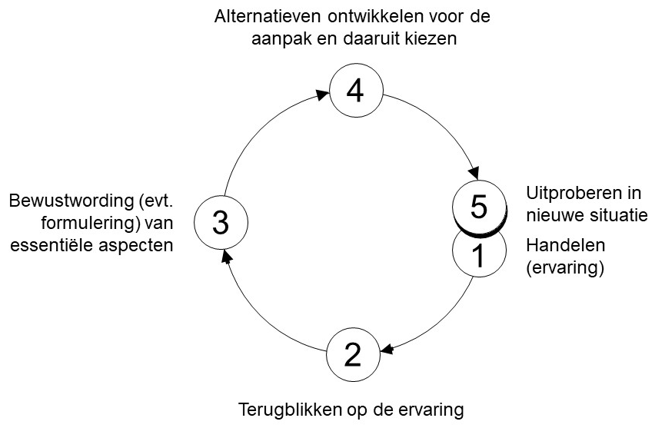
Reflectiespiraal Korthagen

Slide 28
Diagnose en interventie
(Van Es, 2014)
Startvraag 1 | Startvraag 2 | Startvraag 3
Wat is er volgens jou aan de hand? | Wat stoort je in de organisatie? | Waar ligt je wakker van?
Wat bedoel je daar precies mee? | Waardoor is dat ontstaan? | Waar komt dat door?
Waar hangt dat nog meer mee samen? | Waarom kan jou dat wat schelen? | Waarom vind je dat erg?

Slide 29
Diagnose en interventie
(Van Es, 2014)
Startvraag 1 | Startvraag 2 | Startvraag 3
Wat is er volgens jou aan de hand? | Wat stoort je in de organisatie? | Waar ligt je wakker van?
Wat bedoel je daar precies mee? | Waardoor is dat ontstaan? | Waar komt dat door?
Waar hangt dat nog meer mee samen? | Waarom kan jou dat wat schelen? | Waarom vind je dat erg?
Wat vraagt dat van mij/ van mijn afdeling / van onze corporatie?

Slide 30
Aanleiding voor reflectie
Wanneer

Slide 31
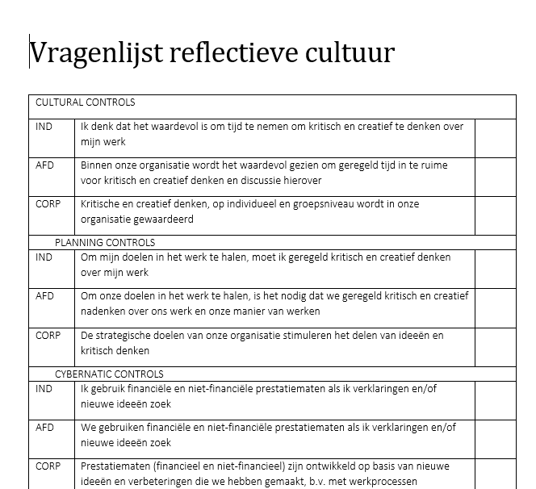
Aanleiding voor reflectie
‘Gevoelssignaal’
  Dit zit met niet lekker
  Dit kan beter
  Hier ben ik tevreden over
Als het schuurt
Als het goed gaat
Op grond van vragenlijst …

Slide 32
Dank voor uw inbreng
Tot ziens bij de afsluiting
Succes met reflectie

Slide 33
Geenen, M.-J. (2014). De reflectieve professional . Uitgeverij Coutinho.
Groen, M. (2008). Effectief handelen door reflectie : bekwamer worden als professional. Wolters-Noordhoff.
Groen, M. (2011). Reflecteren: de basis: op weg naar bewust en bekwaam handelen (Vol. 2). Groningen: Noordhoff.
Merchant, K. A., & Van der Stede, W. A. (2007). Management control systems: performance measurement, evaluation and incentives (2nd ed.). Pearson Education Limited.
Pekkola, S., Hildén, S., & Rämö, J. (2015). A maturity model for evaluating an organisation’s reflective practices. Measuring Business Excellence, 19(4), 17–29. https://doi.org/10.1108/MBE-05-2014-0011
Malmi, T., & Brown, D. A. (2008). Management control systems as a package-Opportunities, challenges and research directions. Management Accounting Research, 19(4), 287–300. https://doi.org/10.1016/j.mar.2008.09.003
Reflectiespiraal Korthagen van: https://korthagen.nl/
Es, R. van. (2014). Praktijkboek veranderdiagnose : De onderstroom van organiseren. Deventer: Kluwer.

