Slide 1
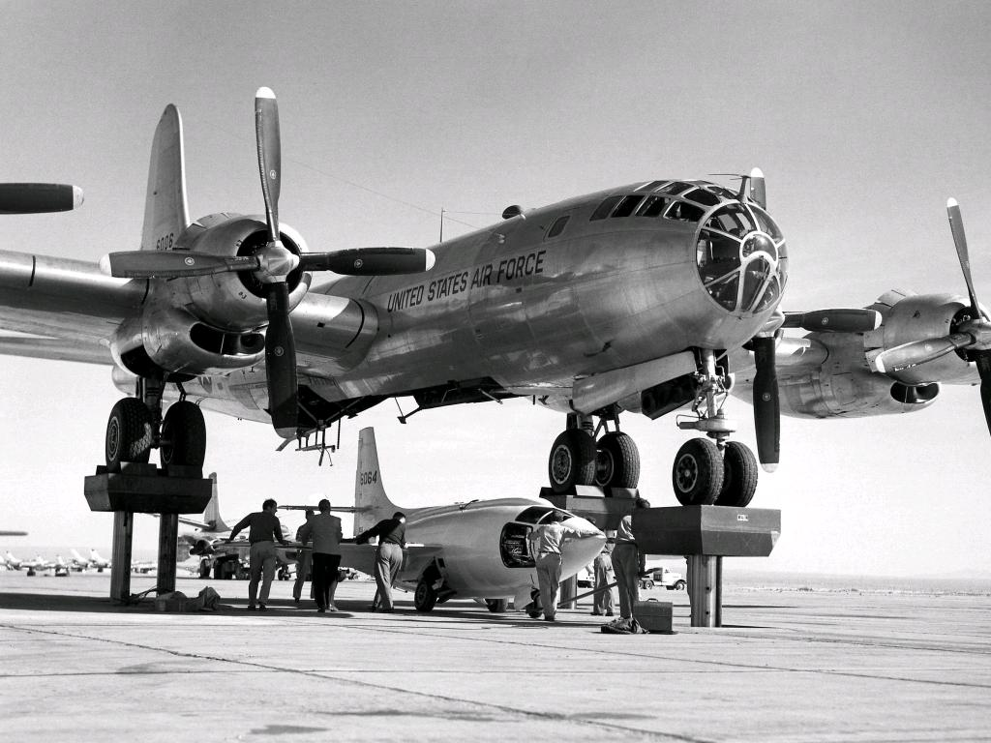
HFAS|RX
6 APRIL 2016

Slide 2

SHAPE 2.0
VLIEGER 2020
cc: premasagar - https://www.flickr.com/photos/54304913@N00

Slide 3

Operatie
Task
Predetermined
Components
Core Competency
Observatie
Gedrag
Instructor
Determined
Components
Barrier
Other
Training
VAN GEDRAG NAAR METEN EN STUREN

Slide 4
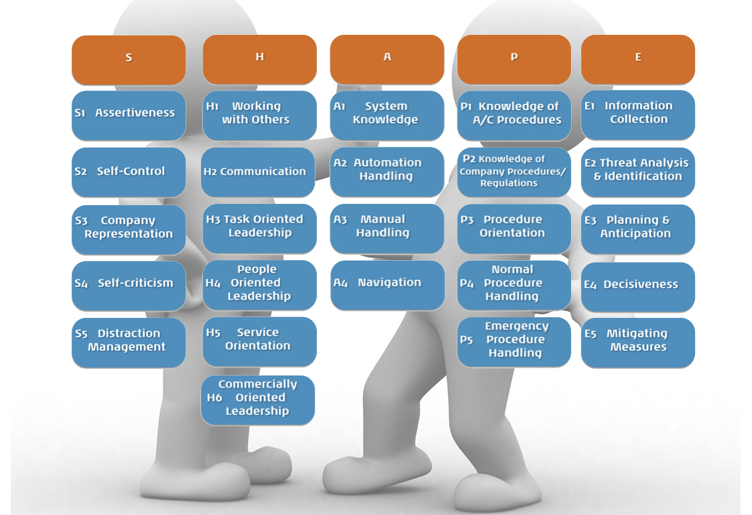
SHAPE 2.0

Slide 5
ýþ
Application of Procedures
P1, P2, P3, P4, P5
Communication
H1, H2, H3, H4,
P2, P3
Manual Control
A2, A3, A4
S5, E1, E2
Automation
A2, A3, A4
S5, E1, E2
Leadership & Teamwork
H1, H3, H4,
S1, S2, S4
Problem Solving & Decision Making
E1, E2, E3, E4, E5, H3, S5
Situation Awareness
E1, E2, E3, E4, A4, S1, S4, H3
Workload Management
S1, S2, S5, H3, H4, E1, E3
SHAPE 2.0 Mapping op ICAO Pilot Core Competencies

Slide 6

(E4) DECISIVENESS
Take decisions related to situational control
Desired components:Takes a decision when necessary
Not Desired components:Does not take a decision when necessary

Slide 7
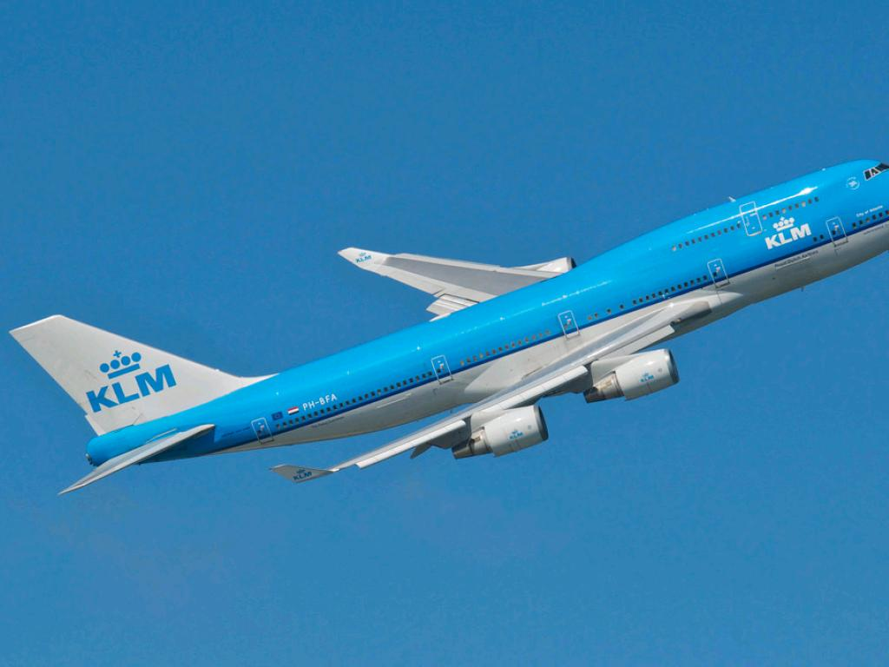
TYPE QUALIFICATION
LEREN VLIEGEN ANNO 2016

Slide 8
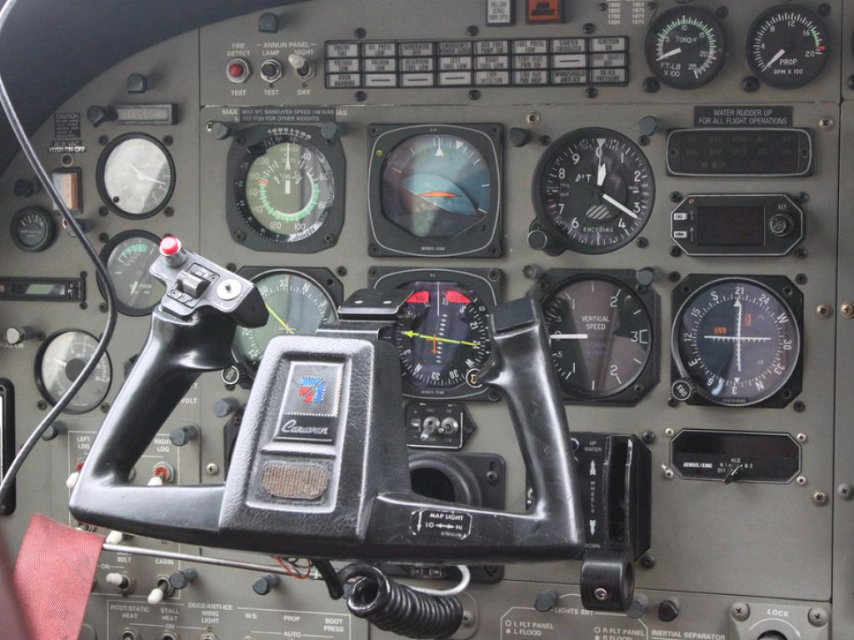
MODULE 1: CORE FLYING SKILLS
Manual flying
Raw data
"Whole task"

Slide 9

MODULE 2: BUILDING BLOCKS
Normal Ops
Adding AP/FD
Systems
Abnormals

Slide 10

MODULE 3: INTEGRATION
Whole task
LOFT
Recurrent level

Slide 11

WHAT ELSE?

Slide 12

DIGITALISERING
IN DE COCKPIT

Slide 13

APPS & MEER
Operatie
Training
Interactie met bedrijf
Interactie met klant
Social media

Slide 14
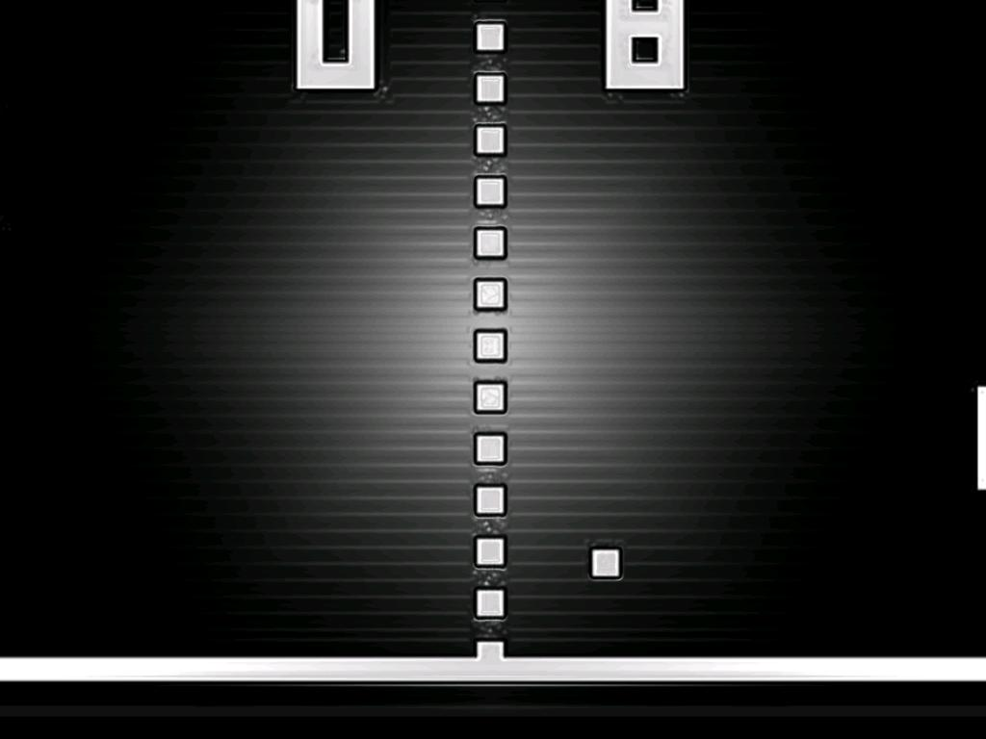
VIRTUAL AIRCRAFT VISIT
B787 CABIN CREW TRAINING

Slide 15

SERIOUS GAMING
SAMENWERKING MET ANNIEK CORPORAAL & T-XCHANGE

Slide 16
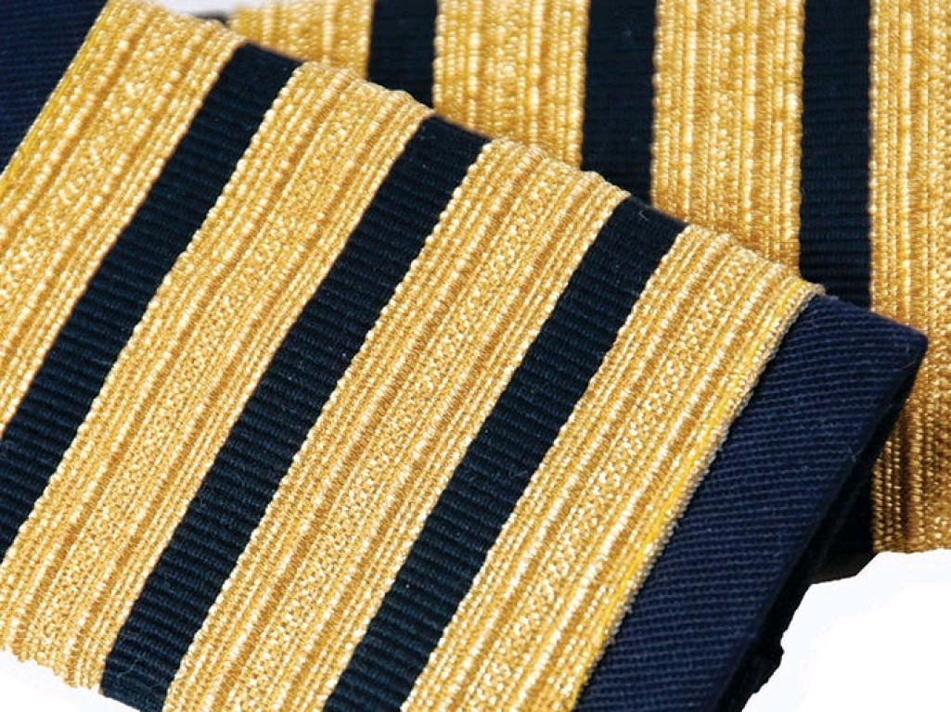
THE SWEET SPOT OF CONFLICT
PROMOTIE EVA VAN DER FLUIT

Slide 17
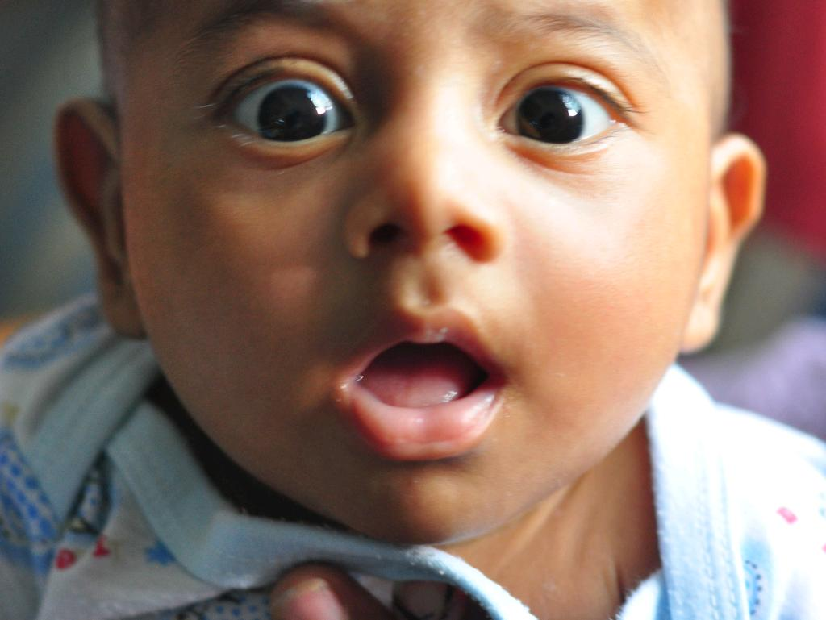
STARTLE & SURPRISE
SAMENWERKING MET NLR

Slide 18

NEXT
Virtual fire fighting
Microsoft Hololens
ATQP big data analyse

Slide 19
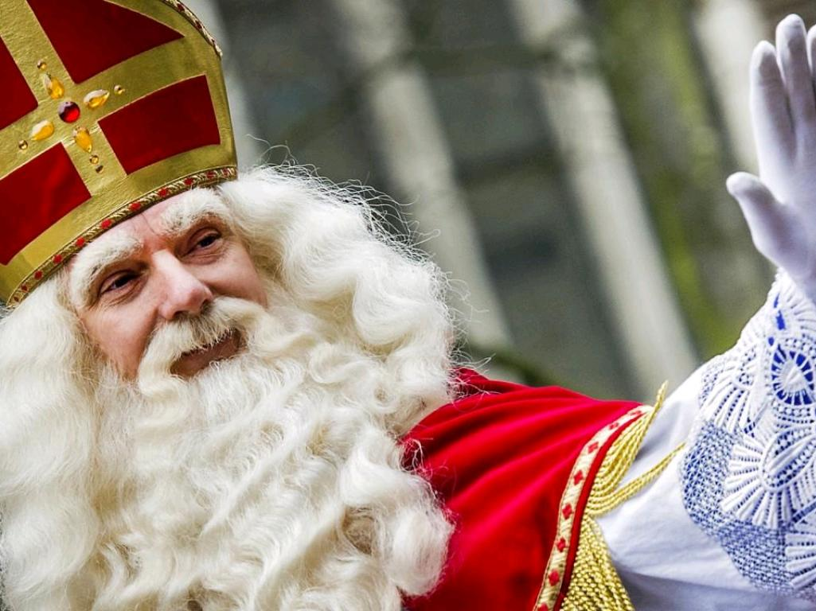
WENSENLIJST
Nog meer serious gaming
Virtualisatie Equipment
Resilience training
Gewenst gedrag naar training
Pro actieve vluchtuitvoering
Decision support

